Slide 1
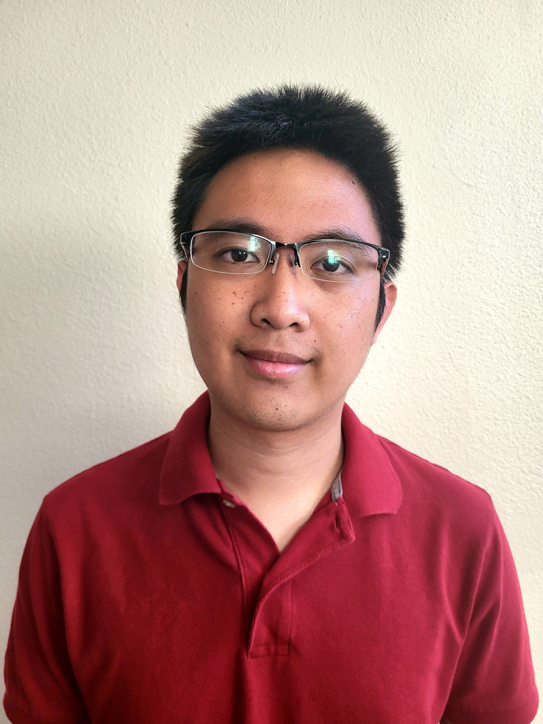
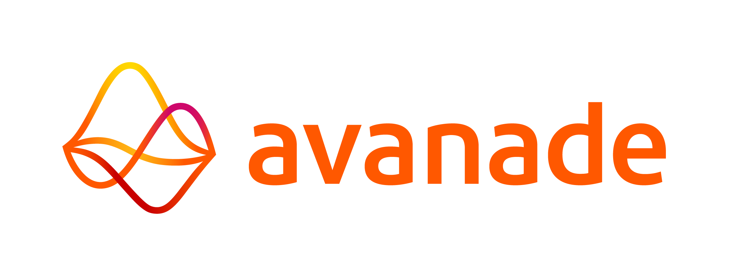
Ryan Millares
Key Selected Experience
Analyst, Full Stack Developer
Avanade – Full Stack Developer
Relevant technologies: ReactJS, NodeJS, C#/.NET, Azure DevOps
Ryan worked as a full stack developer for Avanade on an internal web application that calculated and compared the costs of migrating operations to an Azure Infrastructure-as-a-Service (IaaS) or Platform-as-a-Service (PaaS) based on customizable fields for virtual machines, databases, AppService, and APIs. Primary responsibilities included leveraging ReactJS to implement new features and enhance the UI, implementing new backend API endpoints in C#/.NET to add CRUD features to the app, integrating the API endpoints into the frontend, and managing project sprints and backlog items on Azure DevOps.
Large Auto Insurance Company – Full Stack Developer
Relevant technologies: Angular, Typescript, HTML5, C#/.NET, Azure DevOps, GitHub
Ryan worked as a full stack developer for a large auto insurance company seeking to modernize their quote creation process with Azure-supported cloud storage for security, mobile-first design for user convenience, and improved navigation and features for enhanced experience. Primary responsibilities included using HTML5 and Typescript within Angular to create frontend forms for crucial application features supported with smart data persistence, an intuitive UI for searching the quote database through numerous filters/parameters, utilizing backend API calls to connect the front-end forms to a database hosted on SQL Server Management Studio, and performing rigorous testing to implement solutions for edge-cases (e.g., a user directly routing to a page that needs prior info to load). Used Azure DevOps and GitHub through Agile practices to coordinate code branches, pushes, and merges with rest of team.
Intermediate Software Development Company – Application Developer
Relevant technologies: C#, .NET Programming, Azure DevOps, GitHub, RESTful API
Ryan worked as an application developer for an intermediate software development company on numerous tasks and projects geared towards transitioning company assets away from legacy code. Primary responsibilities included utilizing C#/.NET Programming for internal file validation to check specific requirements, researched and implemented workarounds for limits with Sharepoint and RESTful API calls, and collaborated with testers and consultants on the creation of Microsoft Installer (MSI) tests while using Azure DevOps and GitHub to coordinate merges and version updates to the primary software.
Software Engineering
Avanade, Inc.
Los Angeles Song 5418 McConnell Ave
ryan.millares@avanade.com
Mobile: (949) 276-1774
Areas of Expertise
Technical
C# / .NET Programming
Angular, Reactjs
Typescript/Javascript, HTML, CSS
Azure DevOps, GitHub
Industry
Information Technology
Research and Development
Insurance
Professional Background
Ryan Millares is a software engineer at Avanade with experience in designing and implementing software solutions across various industries. He has hands-on experience working with full-stack and back-end technologies in the development of software and web applications. He has strong understanding of Agile Project Management through Azure DevOps and is experienced with collaborating with team members to see a project through its lifecycle.
Certifications
Azure Fundamentals (AZ-900)

